Slide 1
Introduction to Deep Learning
Lecturer: Van Khoa LE

Slide 2
Introduction

Slide 3
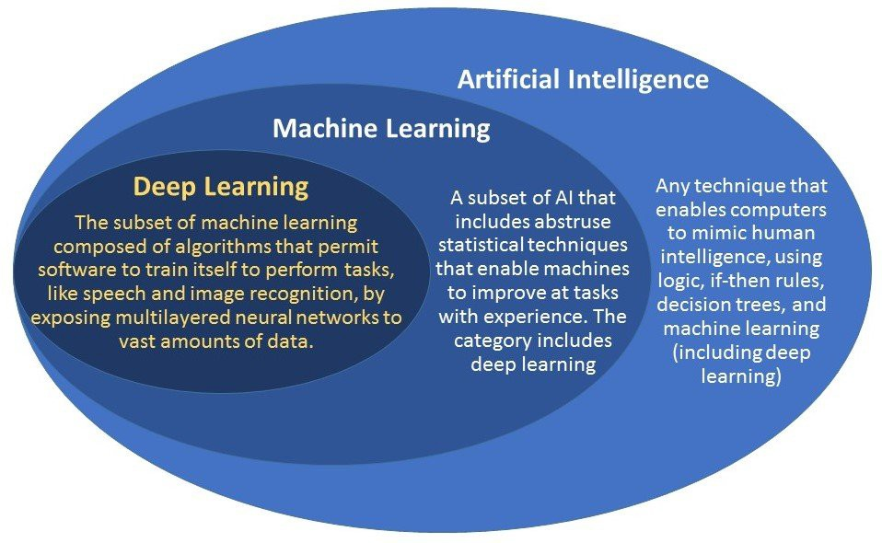
Terminology
Notes:
https://www.apps4bcn.cat/machine-learning-deep-learning-similitudes-et-differences/
AI (Artificial Intelligence)
https://ongxuanhong.wordpress.com/2017/09/04/ai-machine-learning-deep-learning-phan-biet-nhu-the-nao-cho-dung/#more-13839
Machine Learning: Machine learning is the subfield of computer science that “gives computers the ability to learn without being explicitly programmed
Machine Learning là một lĩnh vực nhỏ của Khoa Học Máy Tính, nó có khả năng tự học hỏi dựa trên dữ liệu đưa vào mà không cần phải được lập trình cụ thể.
Deep Learning:

Slide 4
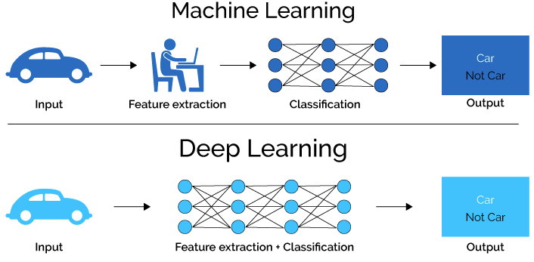
Machine Learning vs Deep Learning
Notes:
https://lawtomated.com/a-i-technical-machine-vs-deep-learning/

Slide 5

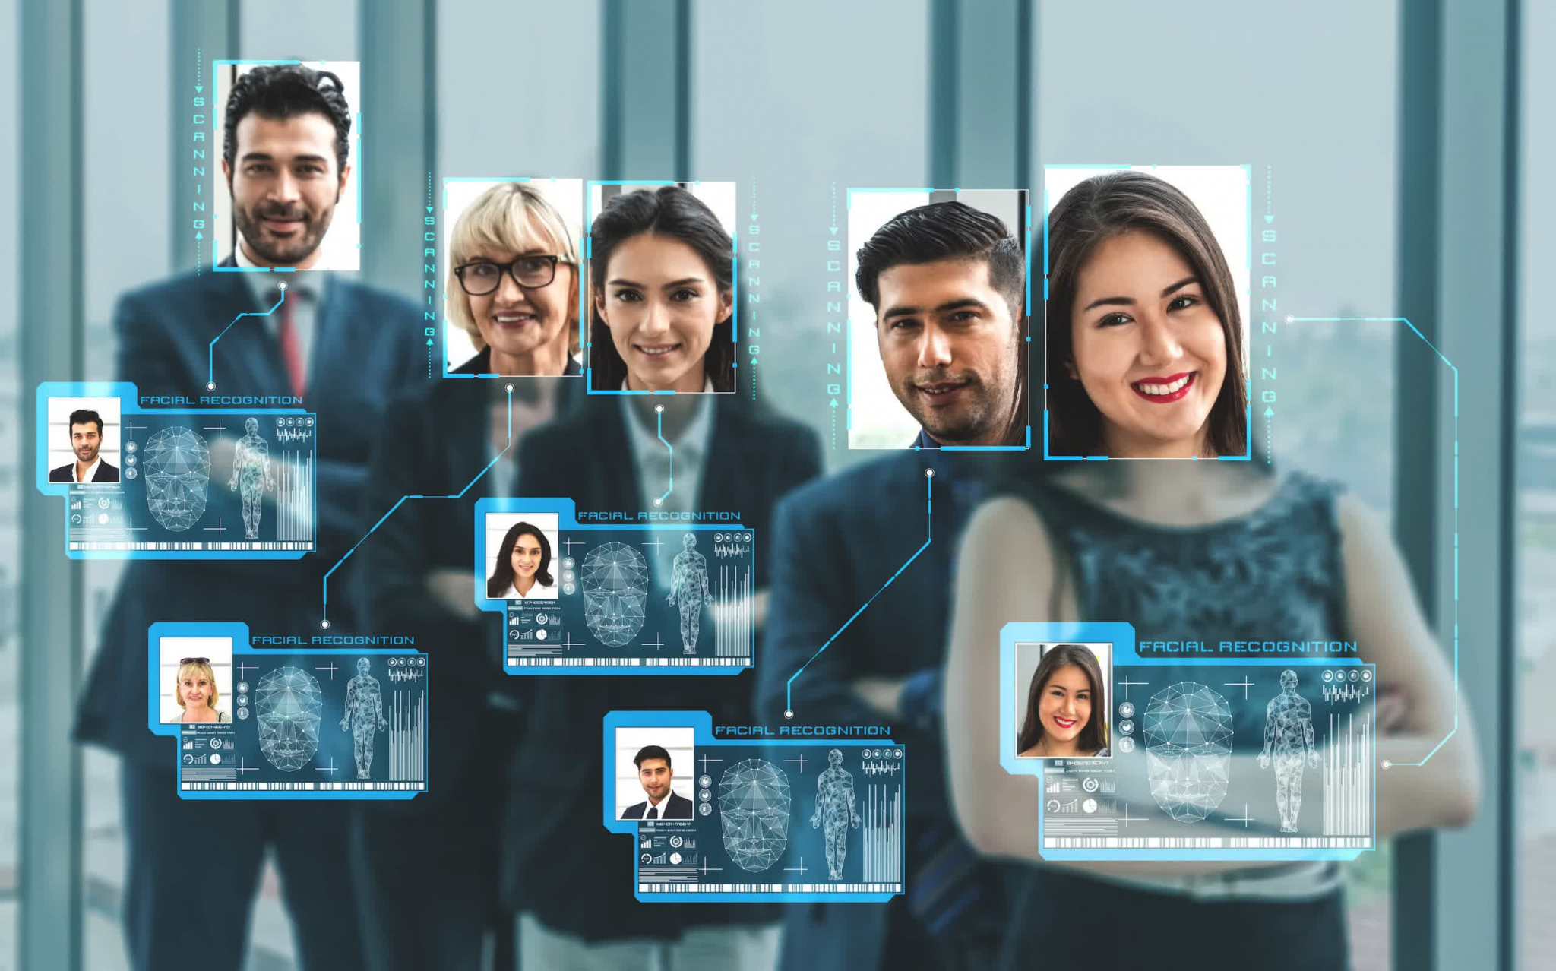

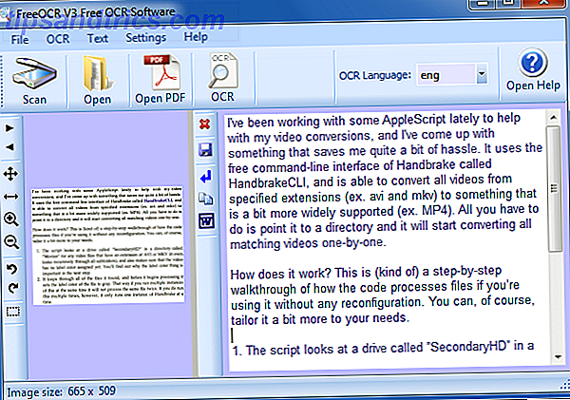
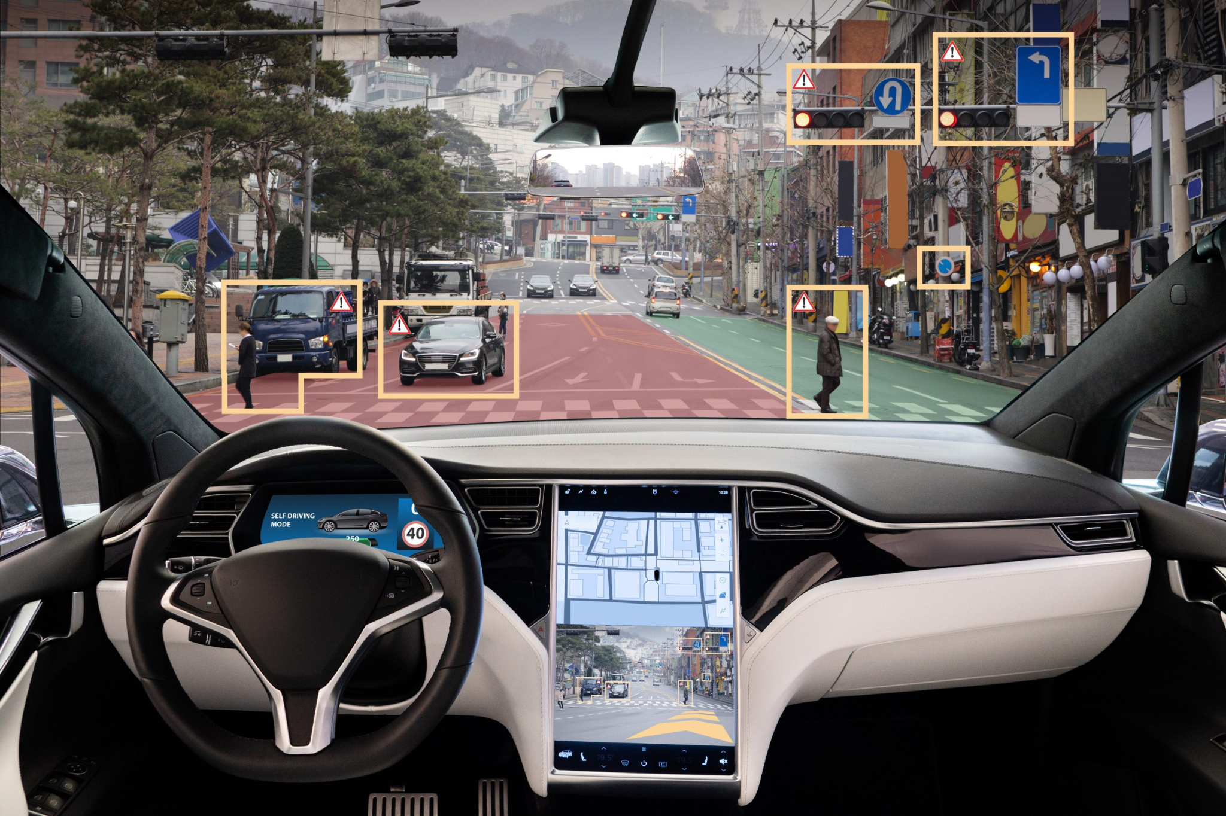
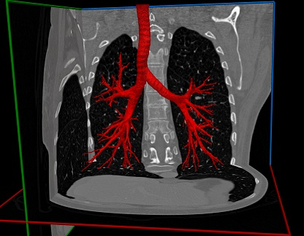

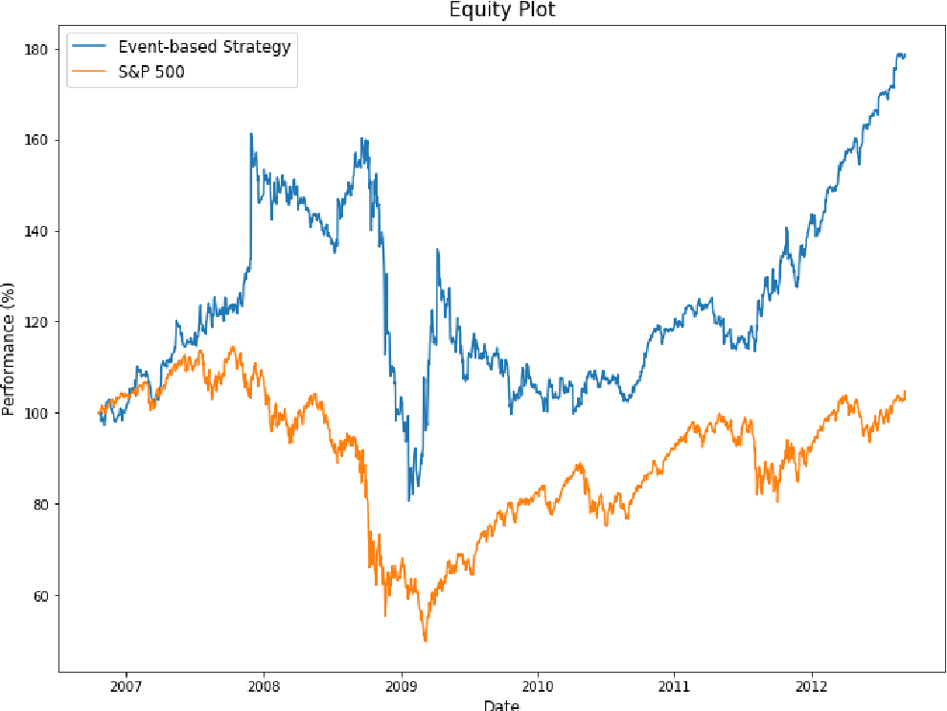
Deep Learning application
Notes:
https://www.techspot.com/news/92684-french-privacy-authority-demands-clearview-ai-flush-facial.html
https://fr.tipsandtrics.com/5-best-ocr-tools-751563
https://www.ptolemus.com/topics/autonomous-vehicles/
https://www.rsipvision.com/airways-segmentation/
https://www.semanticscholar.org/paper/Stock-Market-Prediction-with-Deep-Learning%3A-A-Model-Pinheiro-Dras/8a6961766ed2561668f21d2a3d391b79c936c5e1

Slide 6
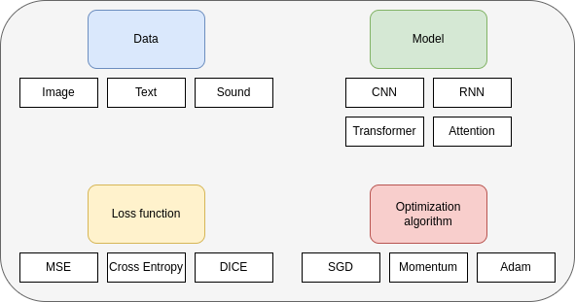
Key components of deep learning
Notes:
https://d2l.ai/chapter_introduction/index.html

Slide 7

Supervised learning

Slide 8
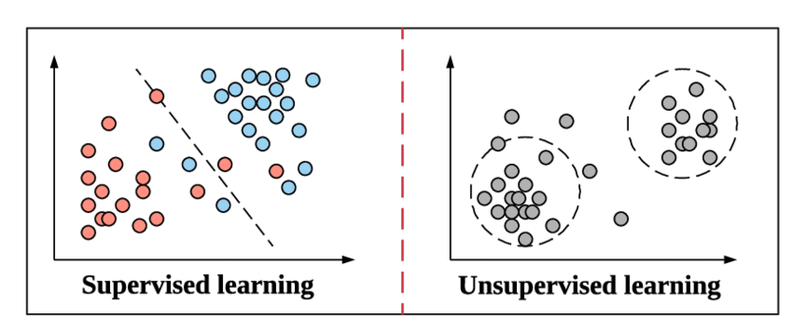
Unsupervised and Self supervised
Notes:
https://lentrepreneur.co/definition/apprentissage-non-supervise-unsupervised-learning-04072021

Slide 9
History
Decade | Dataset | Memory | FLOPS | Algorithm
1940 |  |  |  | Multilayer perceptrons
1970 | 100 (Iris) | 1 KB | 100 KF (Intel 8080)
1980 | 1 K (House prices in Boston) | 100 KB | 1 MF (Intel 80186)
1990 | 10 K (optical character recognition) | 10 MB | 10 MF (Intel 80486) | CNN LSTM
2000 | 10 M (web pages) | 100 MB | 1 GF (Intel Core)
2010 | 10 G (advertising) | 1 GB | 1 TF (Nvidia C2050) | Dropout Attention GAN Transformer
2020 | 1 T (social network) | 100 GB | 1 PF (Nvidia DGX-2)

Slide 10
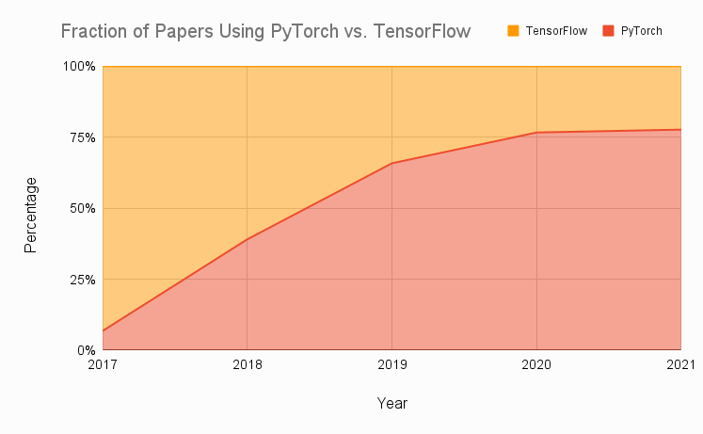
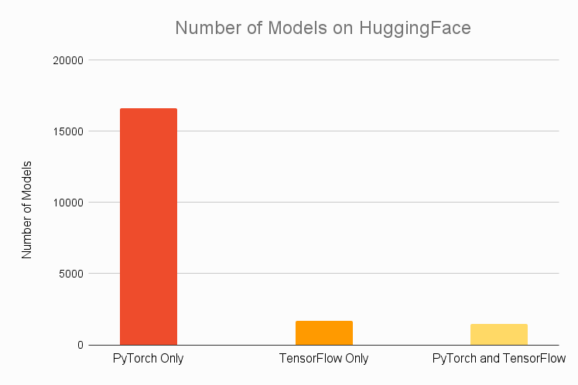
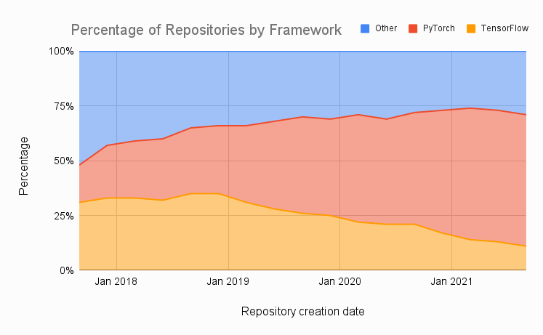
Framework
Notes:
https://www.assemblyai.com/blog/pytorch-vs-tensorflow-in-2022/

Slide 11
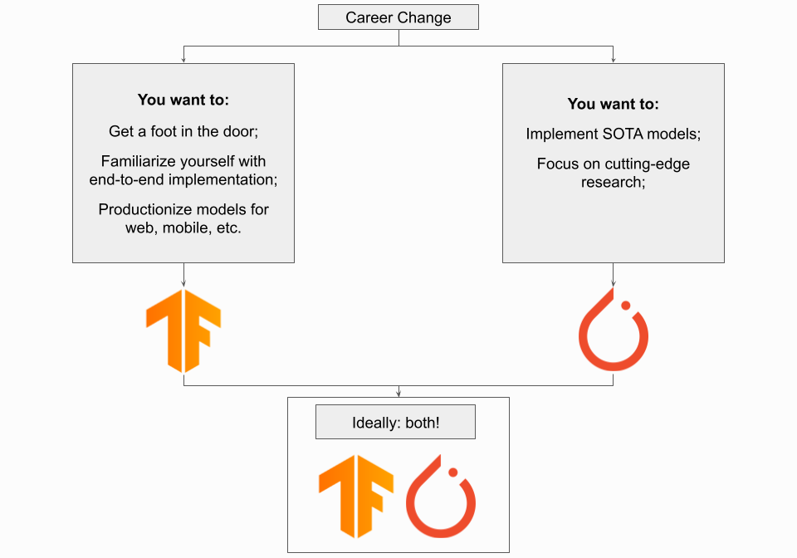
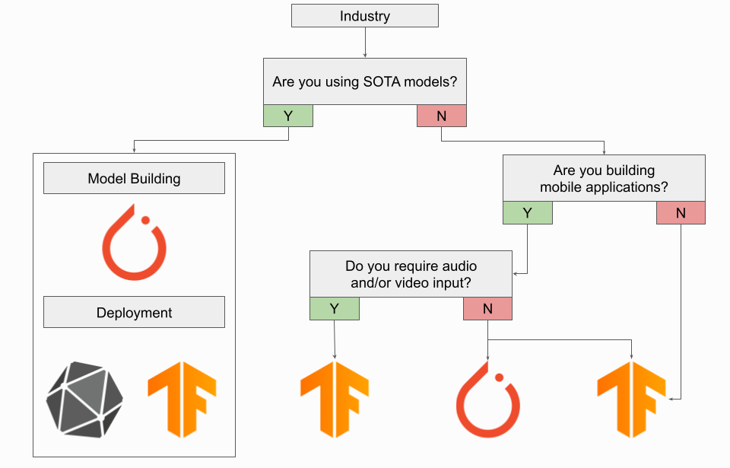
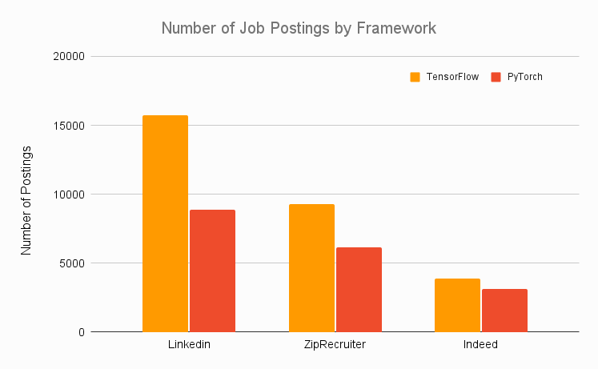
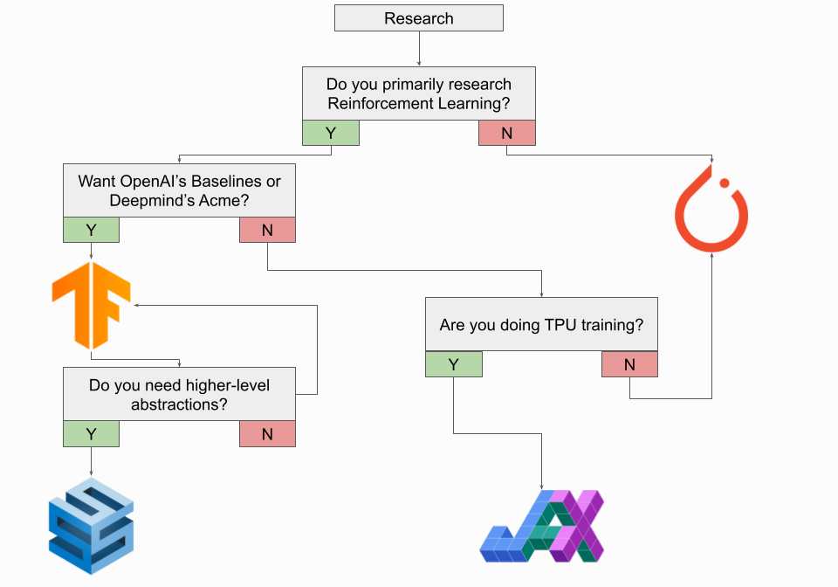
Framework
Notes:
https://www.assemblyai.com/blog/pytorch-vs-tensorflow-in-2022/

Slide 12
Course content
 | Li thuyet | Thực Hành
Tuần 1 | Introduction | Lam quen voi tensor, cac ham co ban cua tensorflow va keras
Tuần 2 | Artificial Neural Network và Deep Neural Network | - Dataloader, optimizer, loss, metrics - MNIST or Fashion MNIST classification with ANN
Tuần 3 | Mạng neuron tích chập (Convolutional Neural Network) -overfitting and underfitting | - Nhận dạng chữ số viết tay MNIST - Nhận dạng sản phẩm thời trang
Tuần 4 | Một số kỹ thuật cải tiến CNN - BatchNorm/LayerNorm - Dropout | - Nhận dạng MNIST - Nhận dạng sản phẩm thời trang
Tuần 5 | Mạng neuron hồi quy (Recurrent Neural Network) LSTM, GRU -diminish gradient, explode gradient | - Thực hành trên time series data - Thực hành với dữ liệu chuỗi thời gian, dự đoán dữ liệu chứng khoán
Tuần 6 | Cơ chế Attention Kết hợp Attention vào LSTM, GRU, transformer | - Thực hành NLP để phân tích phản hồi khách hàng

Slide 13
Course content
 | Li thuyet | Thực Hành
Tuần 7 | Làm quen với lập trình Pytorch - Augmentation - Segmentation - U-Net | Lam lai mot bai tap classification with pytorch - segmentation with medical images
Tuần 8 | Object detection voi YOLO Anchors, input, output, RetinaNet | - YOLOv3, YOLOv4, YOLOv5 - Ứng dụng mạng Darknet cho YOLO - Nhận dạng các loài vật trong ảnh (supervised learning)
Tuan 9 | OCR | OCR
Tuần 10 | Generative networks AE, VAE GANS | - Thực hành AE trên MNIST - Thực hành AE trên dữ liệu số
Tuần 11 | Graph Neural Network | Xây dựng GNN gợi ý phim, sản phẩm cần mua
Tuần 12 | - Transfer-learning - Project cuối khóa | - Từ bài toán nhận dạng vật dụng sang bài toán nhận dạng thời trang - Ôn tập & Trình bày project

Slide 14
Linear model

Slide 15
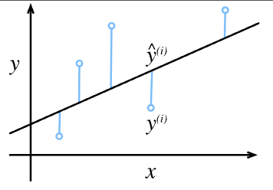
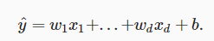
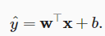
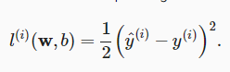
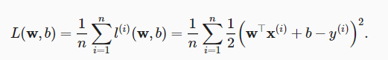
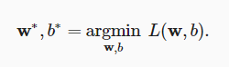
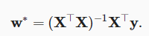
Linear model
Linear model
Loss function
Solution

Slide 16
Linear model (example)
Make an example, give numbers, solve with derivation

Slide 17
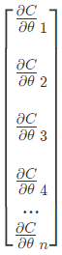
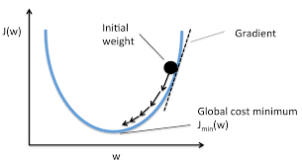
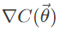
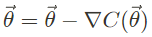
Gradient descent
Get the gradient vector
Update weight
Notes:
Differentiable and convex
https://machinelearningcoban.com/2017/01/12/gradientdescent/

Slide 18
Gradient descent example
and gradient descent

Slide 19
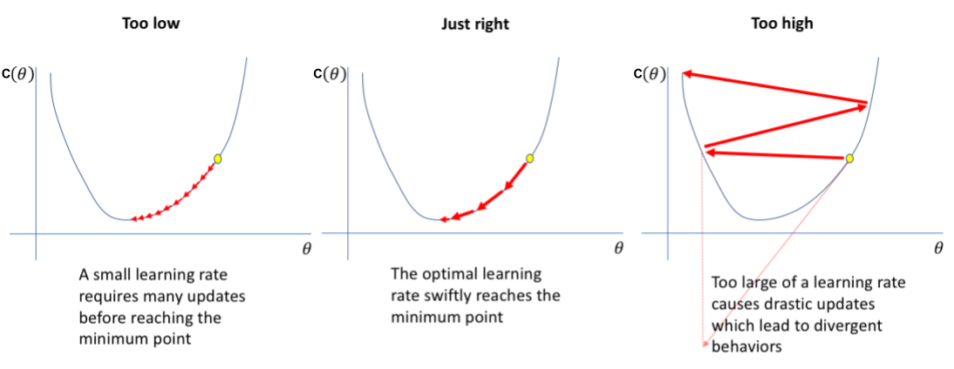
Learning rate

Slide 20
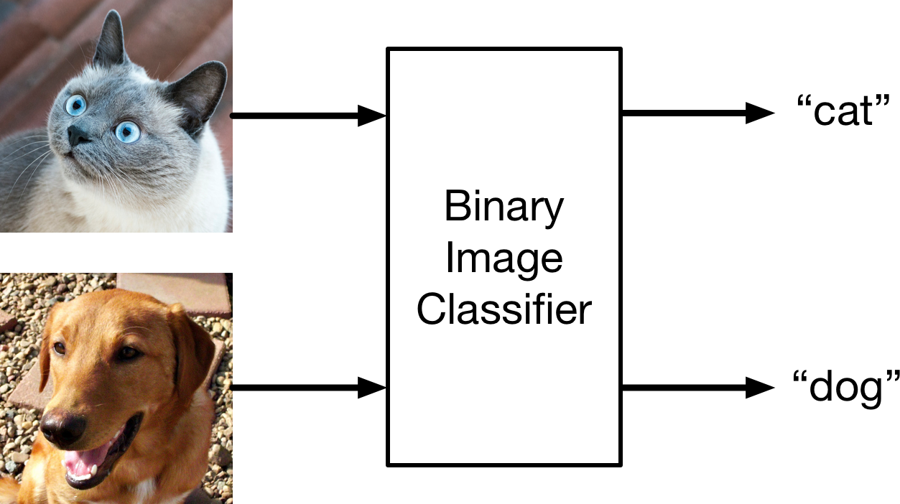
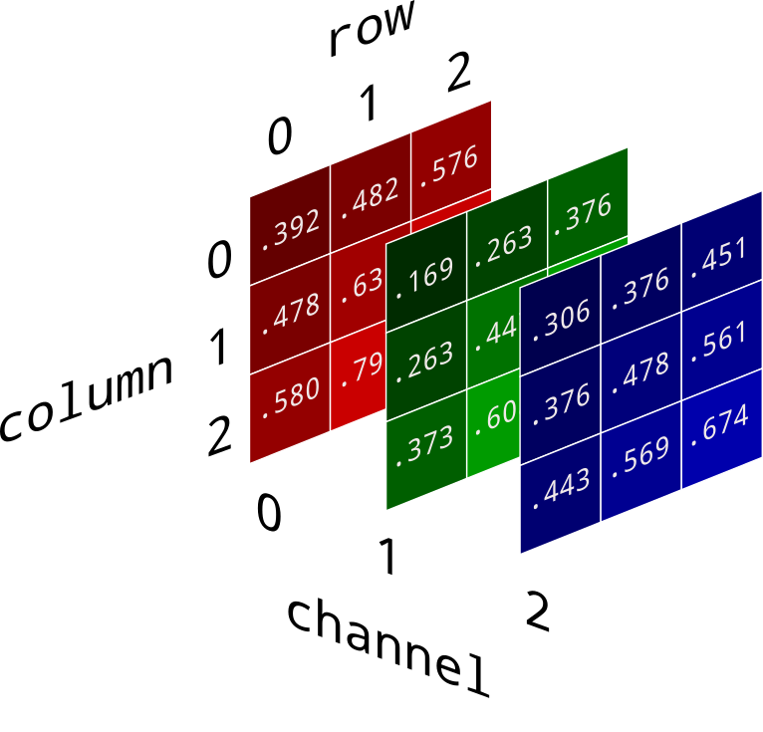
Binary classification

Slide 21
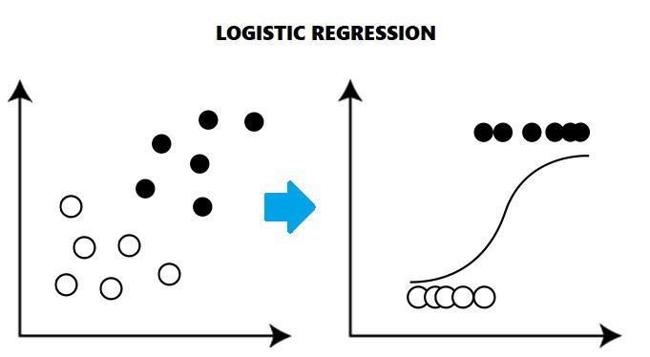
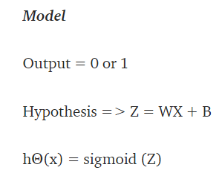
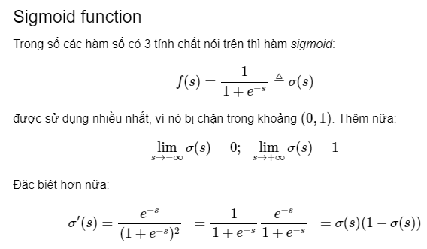
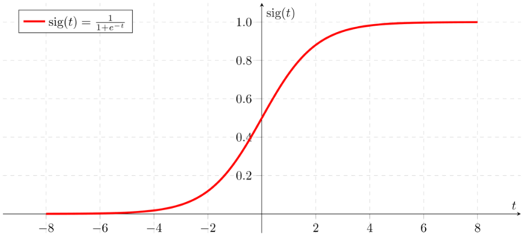
Logistic regression

Slide 22
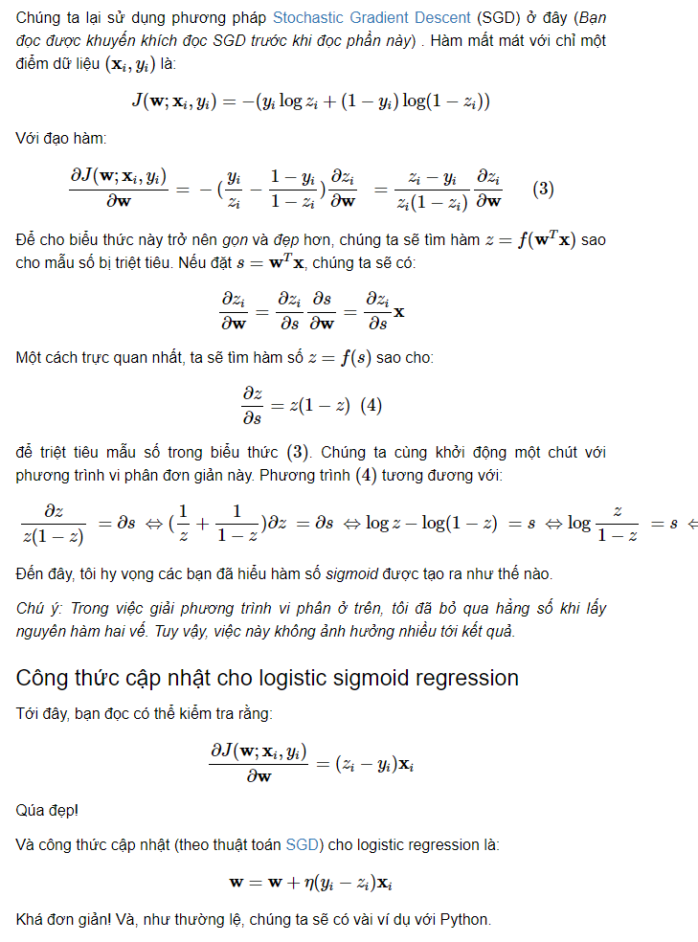
Cross Entropy

Slide 23
Example (theory and code)

Slide 24
Linear Algebra

Slide 25
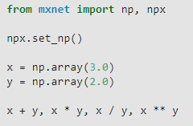
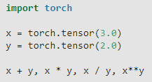
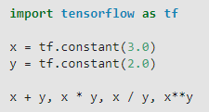
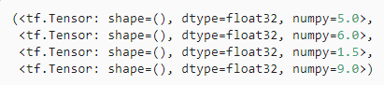
Scalar

Slide 26
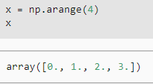
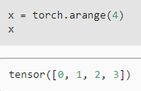
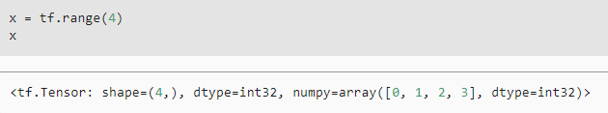
Vectors
Notes:
vector as simply a list of scalar values

Slide 27
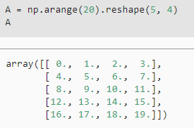
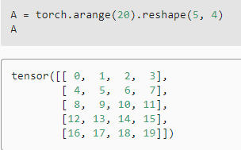
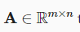
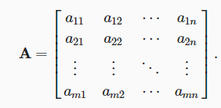
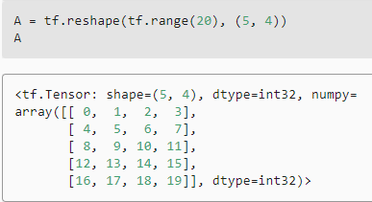
Matrices

Slide 28
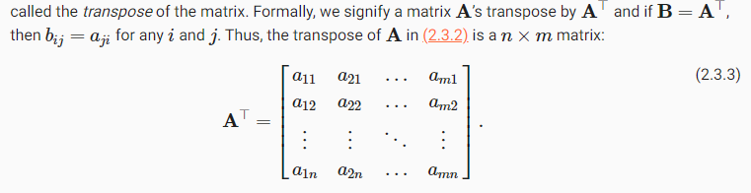
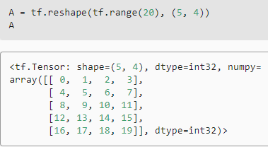
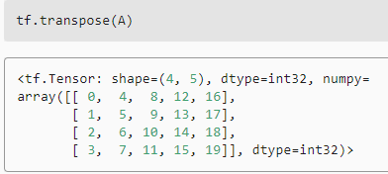
Matrices transposed

Slide 29



Tensors

Slide 30



Basic properties of tensor arithmetic
Copy, allocating new memory
Elementwise multiplication(Hadamard product)

Slide 31






Basic properties of tensor arithmetic
Reduction
Sum
Mean
cumsum

Slide 32




Basic properties of tensor arithmetic
Dot products
Matrix vector product
Matrix matrix multiplication

Slide 33



Basic properties of tensor arithmetic
Norm

Slide 34
Calculus

Slide 35

Derivatives and Differentiation

Slide 36

Derivatives and Differentiation

Slide 37

Gradients

Slide 38

Chain Rule

Slide 39
Probability
Notes:
https://aicurious.io/posts/xstk-khai-niem/

Slide 40


Basic theory
Law of large numbers: as the number of tosses grows this estimate will draw closer and closer to the true underlying probability

Slide 41

Random variables

Slide 42


Multiple random variables
Joint
Bayes
Independence

Slide 43

Expectation and variance

Slide 44
Summary

Slide 45
Summary
AI is applied in several domain
Deep learning invented long ago, recently popular with hardward and data
Pytorch and tensorflow are two most popular frameworks
Preresiquites for deep learning include:
linear algebra, calculus, probability

Slide 46
Reference

Slide 47
Data type
Image
Sound
Text

